Slide 1
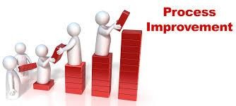
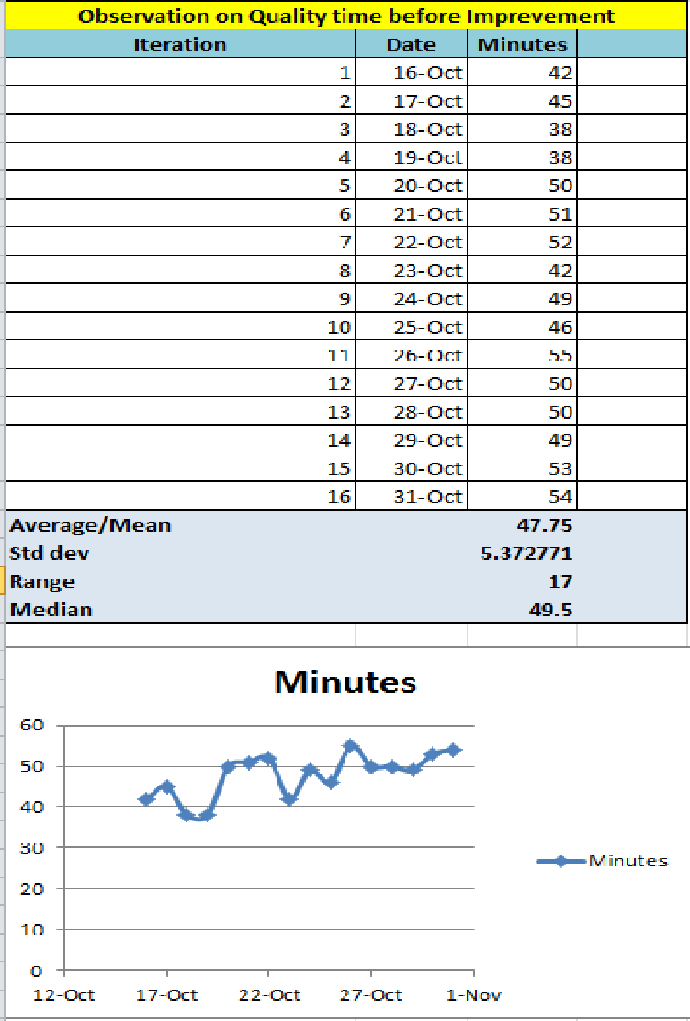



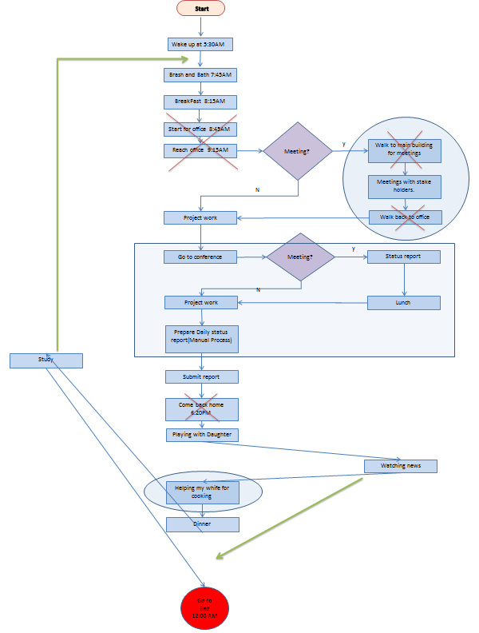
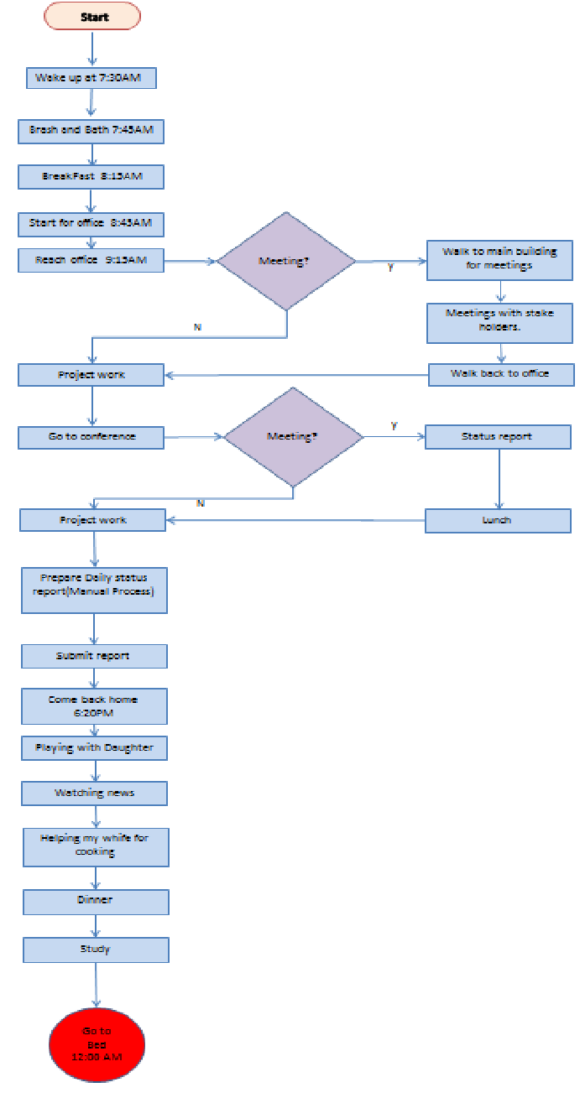
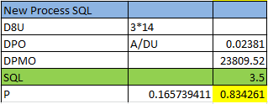



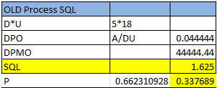




Process Improvement Project - Increasing Quality Time
Process owner - Debasis Chatterjee(SUID: 233176962)
Key Dates - Define(10/12 - 10/15) Measure (10/16 - 10/31) Analyze (11/01 - 11/08) Improve (11/09 - 11/24)
Control (11/25 - 12/10)
DEFINE MEASURE
Problem Statement :
Hard to find quality time with my dayghter. Finding 45minutes to an hour in a day is very challanging in my daily schedule.
ANALYZE IMPROVE
Too many steps!
Optimization of the daily activities:
Remove non-value added items and make some process utomated.
Alpha = 0.05, Z = -31.20866 P-Value --> 0, Home is rejected. Mean Quality time increased from 47.75 minutes to 128.44 minutes!
Annual approx savings $24,000/-!
Buseness Impact:
Increase the quality time atleast 2hours which can save $100 per day. This improvement can save around $24000 in a year.
0.12
0.1
0.08
Area Under curve on right
0.06
1-P = The area
Series1
0.04
0.02
0
120
122
124
126
128 130
CONTROL
132 134
Now 83.42% time I can spend over 125minutes with my daughter.
Remove non value addved steps, optimize activity and automate process
Weekly monitor and review process is in place.
Out of control signal = Action plan. Out of contol means some noise beyond LCL in our case i.e. Xbar - Sigma.
Minutes
0.08
Only 34% time I could spend over 50minutes Quality time with my daughter before
140
0.07
120
0.06
improvement
100
0.05
80
After Improvement
0.04
Series1
60
Before
Minutes
0.03
Area Under curve on right
40
0.02
1-P = The area
20
0.01
Hypothesis Test:
H0 : U2 <= U1 Ha: U2 > U1
0
16-Oct
18-Oct 20-Oct 22-Oct 24-Oct 26-Oct 28-Oct 30-Oct 1-Nov 3-Nov 5-Nov 7-Nov 9-Nov 11-Nov 13-Nov 15-Nov 17-Nov 19-Nov 21-
0
0
20
40
60

Slide 2
Problem Definition Worksheet:
Problem statement. My five years daughter feels that I am not spending times with her and always busy with my work and higher study and she is been ignore by me. As an effect while she draws family picture she discard me from her picture but does not forget to add other family members. When one day I was making fun with her and tried to pretend daddy is very sad as she did not add daddy in her picture. In reply she told me that now a days daddy is not spending time with her, not going out with her, not play with her and not spending enough time.
Few days before, probably she was expecting me to play with her, she was standing a little far from me and that time I was really stuck in my work. She probably waits for sometimes and she noticed that I was doing something in my laptop. Then she told her mummy that daddy is working so hard now a days and studying day & night. I realized that she is really sad about it and I should desperately do something to improve our relationship at earliest.
Business impact. This is the relation between the family members, especially between a daddy and a daughter. My daughter is very jolly and outspoken. But she became very quiet now a day. This is not good! She is only five, she just started her life. If she feels she is ignored and by mistake she adopt some other means then it will cost more and she has way to go in her life. What my wife and me are doing is everything for our family and for our daughter. If she derailed because of the loneliness or ignorance all our earnings and hard works will be meaningless. We are spending so much for her extra curriculum (music, swimming, ice skating) which basically she loves to do. But I feel she is not enjoying them as she expects daddy to go with her and I am not able to make my time.
I have to fix this within a month. Broken relationship costs more than anything and can’t be measured in dollar. But if I come straight for instant loss I might lose couple of thousand that I am spending behind her classes and extra curriculums.
When I will see the smile is back on my daughter’s face and she put me back in her family picture and she happily shares her day events with me and my wife, when she won’t feel ignored and started enjoying her loving activities like music, dancing, swimming, ice skating e.t.c, I would feel that my process brought success.
Currently she is going to after school day care for 2 hours from 4:20PM to 6:20PM which cost me additional $100 each day. If I can manage time and can come back home at the time she backs from school then two things will happen one I can spend quality time with her and can save $100 per day over the course of a year = $24000 per year.
Here the key output is my daughter’s success.
Y_{s =} Daughter’s Success
Y_{s} = f(x₁, x₂, Q_{t}, x₃, x₄…)
Problem area = Q_{t,} at this moment other X factor can be ignored. As I know Q_{t} is causing problem.
Q_{t =} Quality time
Where Q_{t} = f(H_{c}, O_{w}, H_{s}, S_{t}, E_{t}) H_{c} = Health Condition
O_{w} = Office Work H_{s} = Higher study S_{t} = Sleeping time
E_{t} = Entertainment time
Goals. This is a nested goal in nature. Even though ultimate goal is to see success in my daughter’s life but the initial goal is to spend quality time with her as this is the problem area in her success. Other factors are not prominent at this age so they can be ignored for now. Currently I have hardly 1hr in a day to spend with her. I am looking for to save another hour so that I can spend more hours and can save extra spending going towards for after school day care.
Project scope. Identify improvements to reduce and adjust event hours and finding more overlap with my daughter’s day charter. I can’t make any change to Office Work timing or schedule. The first step is that I have to stop after hours office work. Last and foremost thing is that I have to find more overlap with my daughter’s schedule.
Team. I am the process owner. I need my wife and daughter to be involved to validate the continuity.
Project plan (very high-level).
Activity | Begin | End
Define | 10/12 | 10/15
Measure | 10/16 | 10/31
Analyze | 11/01 | 11/08
Improve | 11/09 | 11/24
Control | 11/25 | 12/05
Track Benefits | 12/06 | 12/10
Data Measurement Plan Data Stratification Tree :
As Y= f(x1,x2,x3…..). Here Y is out expected output for quality time and x is the input factors needs to be optimized. We have captured our quality time for 16 days before process improvement and another 16 days after process improvement. Quality time is effected by daily scheduled activities. So daily scheduled activities needs to be monitored and optimized for improvised process.
Data is captured manually with very precision using apple stop watch by me. Two type of measurement have been taken. Time measured for each activity throughout the day and processed quality time spend each day before and after improvement throughout the project. It is noticed that before improvement there was maximum 18 activities in a day which is optimized to 14 activities at maximum in a day.
This process could save additional $100 each day over the course of a year = $24000 per year.
Time is a continuous Data. I had very limited time to collect the sample. In my process rick is less because minute or seconds difference does not really make any change to my quality life where as I am looking for to improve 50 minutes to 120 minutes quality time. Larger sample size would be great, but still in one tree hypothesis test n1+n2 = 32 days sample is quite good to measure and analyze.
There could be having some error of seconds. This delta is really very negligible. To avoid this error ‘seconds’ or ‘milliseconds’ can be measured to in future during control.

Slide 3
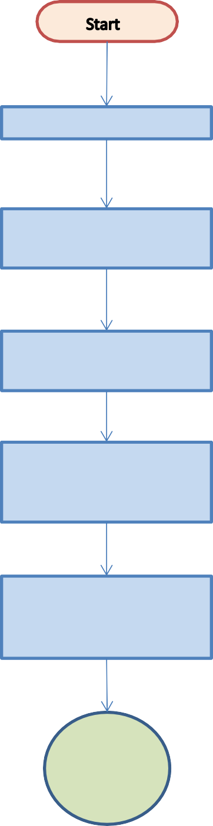
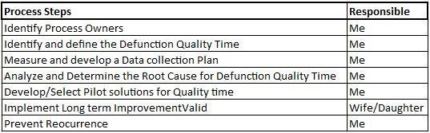
Identify Process Owners
Identify and define the Defunction Quality Time
Track Benefits
Measure and develop a Data collection Plan
Flowchart nodes and Key
Terminator
Process
Connector
Decision
Flow Line
Analyze and Determine the Root Cause for Defunction Quality Time
No
Implement Long term QT. Valid?
Develop/Select Pilot solutions for Quality Time
Yes
Prevent Reocurrence
Track Benefits
End

Slide 4
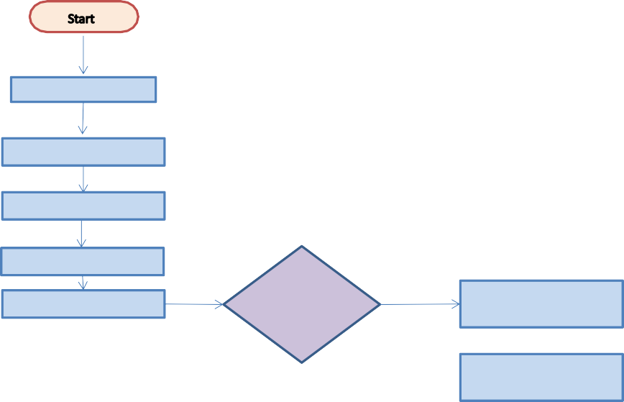

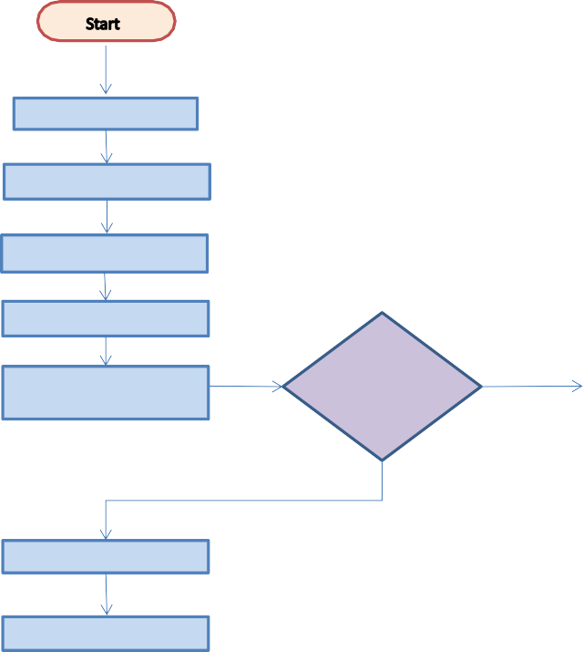
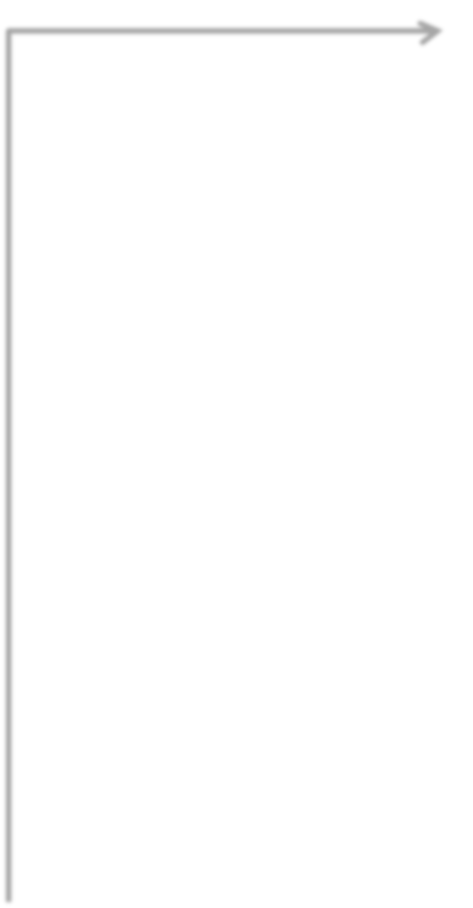









Wake up at 7:30AM
Wake up at 5:30AM
Wake up at 5:15AM
Brash and Bath 7:45AM
Brash and Bath 7:45AM
Brash and Bath 5:45AM
BreakFast 8:15AM
BreakFast 8:15AM
Study
Start for office 8:45AM
Start for office 8:45AM
BreakFast 8:15AM
Reach office 9:15AM
Meeting?
y
Walk to main building for meetings
Reach office 9:15AM
Meeting?
y
Walk to main building for meetings
Login to office from
Meeting?
y
Meetings with stake holders through Webex
N
Meetings with stake holders.
N
Meetings with stake holders.
N
Project work
Walk back to office
Project work
Walk back to office
Project work
Go to conference
Meeting?
y
Status report
Process Improvement
y
N
Improved Process
Lunch
Go to conference Meeting? Status report
Project work Lunch
Prepare Daily status report(Manual Process)
Project work
Project work
N
Lunch
Ask Team to send daily report in a template
Prepare Daily status report(Manual Process)
Submit report
Study
Submit report
Log out from Office
network 4:20PM
Submit report
Come back home 6:20PM
Come back home 6.20PM
Playing with Daughter
Playing with Daughter
Playing with Daughter
Helping my whife for cooking(Shift from Asian food to American or Mexican/Chinise food)
Watching news
Watching news
Helping my whife for cooking
Helping my whife for cooking
Dinner
Dinner
Dinner
Watching News
Study
Go to Bed 12:00 AM
Go to Bed 12:00 AM
Go to Bed 10:00 PM

Slide 5


Old Process
TIME Continuous Data (Measurement)
New Process
Brash & Bath
Activity
Minutes
End time Observed 45 8:15 AM 8:15 AM
30 8:45 AM 8:45 AM
30 9:15 AM 9:20 AM
Brash & Bath
Activity
Minutes
End time Observed 30 5:45 AM 5:45 AM
150 8:15 AM 8:15 AM
30 8:45 AM 8:45 AM
Breakfast
Study
Office travel
15 9:30 AM 9:35 AM
120 11:30 AM 11:35 AM
Breakfast
45 9:30 AM 9:30 AM
120 11:30 AM 11:30 AM
Walking to main building
Project Work
Meeting
Meeting
Back to office
15 11:45 AM 11:45 AM
Project Work
30 12:15 PM 12:15 PM
Project Work
60 12:30 PM 12:30 PM
conference room
5 12:20 PM 12:20 PM
Meeting
30 12:50 PM 12:50 PM
10 1:00 PM 1:00 PM
180 4:00 PM 4:00 PM
60 5:00 AM 5:00 AM
50 5:50 PM 6:15 PM
40 6:30 PM 6:30 PM
30 7:00 PM 7:00 PM
90 8:30 PM 8:30 PM
30 9:00 PM 9:00 PM
180 12:00 AM 12:00 AM
Lunch
Lunch
30 1:00 PM
1:00 PM
Project Work
Project Work
180 4:00 PM
4:00 PM
Report Preparation and submit
Report collection and submit
20 4:20 PM
4:30 PM
Home travel
Quality time
Quality time
130 6:30 PM
6:30 PM
Watching news
Helping wife in cooking
30 7:00 PM
7:00 PM
Helping wife in cooking
Dinner
30 7:30 PM
7:30 PM
Dinner
Watching news/Movies
90 9:00 PM 9:00 PM
60 10:00 PM 10:00 PM
Study
Study
Analyze
Observation on Quality time before Imprevement Iteration Date Minutes
1 16-Oct 42
2 17-Oct 45
3 18-Oct 38
4 19-Oct 38
5 20-Oct 50
6 21-Oct 51
7 22-Oct 52
8 23-Oct 42
9 24-Oct 49
10 25-Oct 46
11 26-Oct 55
12 27-Oct 50
13 28-Oct 50
14 29-Oct 49
15 30-Oct 53
Observation on Quality time after Improvement Iteration Date
9-Nov
10-Nov
11-Nov
12-Nov
13-Nov
14-Nov
15-Nov
16-Nov
17-Nov
18-Nov
19-Nov
20-Nov
21-Nov
22-Nov
23-Nov
24-Nov
Minutes
Hypothesis Testing
Green Chart
n1 + n2 >=30
Large Sample
Alpha = 0.05
125
H0 : U2 <= U1
One Tail Test
Z = -31.20866
P=0
122
Ha: U2 > U1
Lower/Left Tail
121
Old Process
Average Std dev 47.75 5.372771
New Process
126
Minutes
Distribution
Minutes
Distribution Average Std dev 125 0.0703323 128.4375 3.539656
133
42
0.041879518
128
45
0.065136352
122 0.02156323
130
38
0.014309074
121 0.01239486
127
38
0.014309074
126 0.08891529
128
50
0.068018882
133 0.04911032
130
51
0.061838104
128 0.11184888
131
52
0.054304773
130 0.1022436
132
42
0.041879518
127 0.10378519
130
49
0.072269985
128 0.11184888
133
46
0.070416483
130 0.1022436
16 31-Oct 54
129
55
0.02987545
131 0.08672501
Average/Mean Std dev
Range Median
47.75
5.372771
17
49.5
130
50
0.068018882
132 0.06791878
128.4375
3.539656
12
129.5
50
0.068018882
130 0.1022436
49
0.072269985
133 0.04911032
53
0.046065416
129 0.11129233
54
0.037745671
130 0.1022436
Minutes
Minutes
0.08
0.12
60
134
0.07
0.1
50
132
0.06
0.08
40
130
0.05
30
Minutes
128
Minutes
0.04
Series1
0.06
Series1
20
126
0.03
0.04
10
124
0.02
0.02
0
122
0.01
12-Oct
17-Oct
22-Oct
27-Oct
1-Nov
120
6-Nov
11-Nov
16-Nov
21-Nov
26-Nov
0
0
10
20
30
40
50
60
0
120
125
130
135
Compare Chart
Date
Minutes
Improvement
16-Oct
42
17-Oct
45
Minutes
OLD Process SQL
18-Oct
38
D*U
5*18
19-Oct
38
140
DPO
A/DU
0.044444
20-Oct
50
120
DPMO
44444.44
21-Oct
51
SQL
1.625
22-Oct
52
100
P
0.662310928 0.337689
23-Oct
42
80
New Process SQL
24-Oct
49
Minutes
D8U
3*14
25-Oct
46
60
DPO
A/DU
0.02381
26-Oct
55
40
DPMO
23809.52
27-Oct
50
20
SQL
3.5
28-Oct
50
P
0.165739411 0.834261
29-Oct
49
0
30-Oct
53
16-Oct
23-Oct
30-Oct
6-Nov
13-Nov
20-Nov
31-Oct
54
9-Nov
125
10-Nov
122
11-Nov
121
12-Nov
126
13-Nov
133
14-Nov
128
15-Nov
130
16-Nov
127
17-Nov
128
18-Nov
130
19-Nov
131
20-Nov
132
21-Nov
130
22-Nov
133
23-Nov
129
24-Nov
130

Slide 6
Process Steps | Responsible
Identify Process Owners | Me
Identify and define the Defunction Quality Time | Me
Measure and develop a Data collection Plan | Me
Analyze and Determine the Root Cause for Defunction Quality Time | Me
Develop/Select Pilot solutions for Quality time | Me
Implement Long term ImprovementValid | Wife/Daughter
Prevent Reocurrence | Me

